Slide 1
SHUBHENDU MAL
EMPLOYEE ID: 153003
JAVA FULL STACK, MIPL

Slide 2
CapStore Shopping Application

Slide 3
Project Requirements

Slide 4
Softwares:
Java 10
STS Version: 3.9.5.RELEASE
MySQL 5.5 Command Line Client
HTML 5
CSS 3
JavaScript
JSP
Spring Boot (2.0.4)
Spring Rest
Notes:
Fixar a posicao do titulo – sempre do lado esquerdo.
Sempre que tiver muito texto o coluna deve sempre ser “ narrowed” , se nao fica dificil de ler. Colocar paragrafos no texto.
Linha vertical deve ser mais fina e as pontas NUNCA devem ser arredondadas.

Slide 5
MODULE
SENDING LIST OF ATTRACTION TO THE CUSTOMER

Slide 6
Sending List of Attraction
The home page of Admin contains a add new attraction tab and send new attraction tab.
When the admin click on add new attraction tab then AddAttraction.jsp page is open through which admin can add an attraction.
After adding the attraction admin can see all the attraction available to send the customer on ShowAttraction.jsp page.
Now to send the attraction to the customer the admin has to click on send new attraction tab.
After clicking on tab a page called SendMail.jsp is projected.
This page contains details of all the recently logged in customer whom the admin wants to send the attraction through email.
In this page all the active attractions are available .

Slide 7
Sending List of Attraction (Contd..)
Now the admin can choose any attraction at a time to send the mail to the above listed customers.
There is a send mail tab in this page.
After choosing the attraction when admin click on send mail tab the mails are sent to all the above listed customer.

Slide 8
Email
Attribute Name | Data type | Constraint | Description
eId | int | Primary key | Unique
from_emailId | String |  | Email id of admin(Sender)
to_emailId | String |  | Email id of customer(receiver)
Body | String |  | Description of Attraction
subject | String |  | Specification of Attraction
date | Date |  | Date on which the attraction is sent

Slide 9
Customer
Attribute Name | DataType | Constraint | Description
customerId | int | Primary Key | Unique
customerName | string |  | Name of the customer
phoneNumber | double |  | Phone number of customer
emailId | string |  | Email id of customer
dateOfBirth | date |  | Date of birth
lastLogin | date |  | Last date of login
address | string |  | Address

Slide 10
Attraction
Attribute Name | DataType | Constraint | Description
attractionId | int | Primary Key | Unique
attractionName | string |  | Name Of attraction
imageUrl | string |  | Url of the Image
status | string |  | Status of attraction
description | string |  | Description of attraction

Slide 11
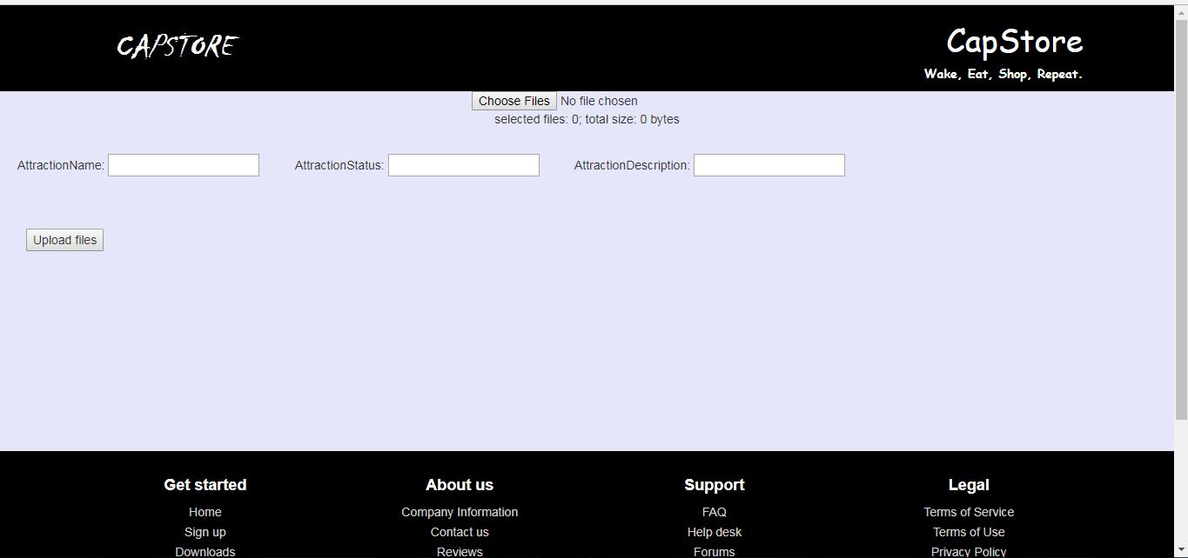
AddAttraction.jsp

Slide 12
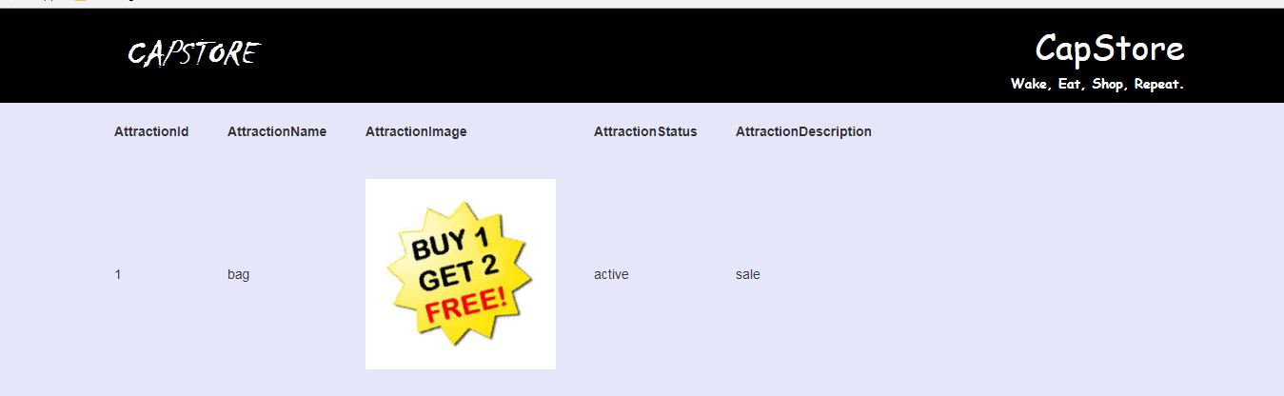
ShowAttraction.jsp

Slide 13
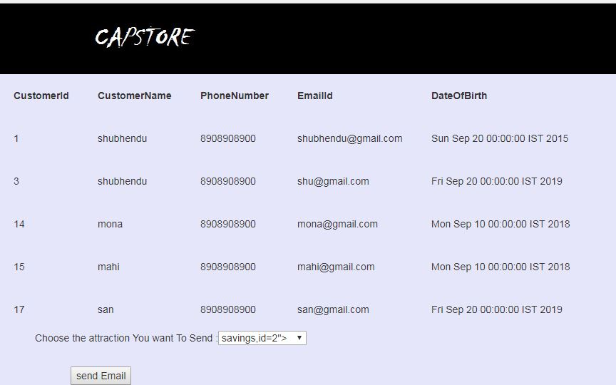
SendMail.jsp

Slide 14
Thank You
Notes:
O Box atras do texto desnecessario. Deixar o layout mais simples.

